Slide 1

Audio
Computer Science 1033 – Week 10
Watch how the music and animation meld
“Adding sound to movies would be like putting lipstick on the Venus de Milo.” → Mary Pickford (Movie Actress from the 1920s)
Notes:
The sancho plan

Slide 2
Overview of This Week’s Topics
Why use sound?
Where can you get sound?
What is sound?
Sample Rate
Sample Size
Sound Editing
Why compress?
How to compress?
File Format
What are MIDI files?
Posting sound on the Web

Slide 3
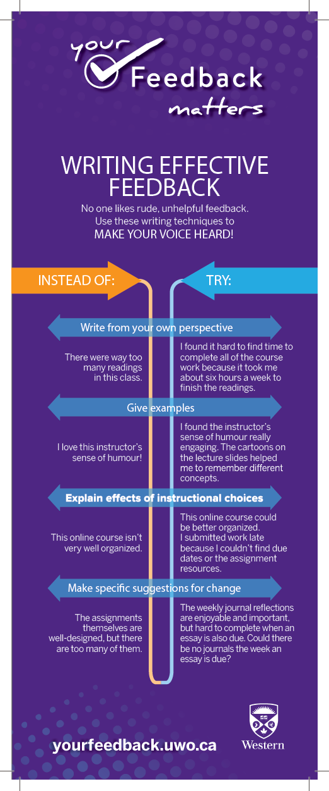
Remember to Let Us Know What You Did NOT Like and What You DID Like About This Course!
Feedback
I wont know who you are ☺ !
Video: https://www.youtube.com/watch?v=Sa4MzTamlWQ
Feedback: Feedback.uwo.ca

Slide 4
Make sure you get a copy of all your work!
Your assignment 2 and 3 websites will only be posted for the next month (till about ONE month after our final exam) so make sure you take a copy of everything you want to save and put it on a memory stick or in the cloud.
ONE MONTH AFTER THE COURSE ENDS YOU WILL NOT BE ABLE TO GET ANYTHING YOU POSTED ON cs1033.gaul.csd.uwo.ca BACK. KEEP COPIES!

Slide 5
Introduction to Sound
Sound can:
Set a mood → http://pictoplasma.sound-creatures.com/#/gallery/sound-19/19-10
Sell, Sell, Sell → http://www.csd.uwo.ca/~lreid/cs033/sound/awardwinningpoo.wav
Educate/Present Information → http://www.cbc.ca/radio/
Allow communication over the web via Internet Audio Conferencing

Slide 6
Where can you get Sound?
Pre-Packaged:
Download sound from companies → e.g. http://soundbible.com/215-Cow-Mooing.html
http://soundbible.com/free-sound-effects-1.html

Slide 7
Where can you get Sound?
Create your own sound:
Recording program with a computer's operating system (such as Sound Recorder) and speak into a microphone attached to the computer – quality will not be the best
Recording studio with equipment such as DAT (Digital Audio Tape) devices that record sounds digitally. Produces a high quality commercial product
Electronic instruments such as synthesizers can be used to create music sound files. Connecting the instrument to a computer allows the sounds to be captured in a MIDI (Musical Instrument Digital Interface) format.

Slide 8
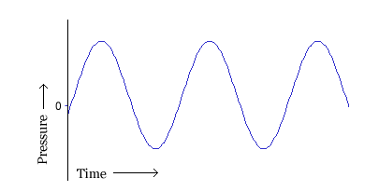
What is Sound?
Sounds are pressure waves of air
Visualize the sounds as a series of recurring waves called a waveform.
Question: Which part of the wave indicates the volume of the sound?
Question: Which part of the wave indicates the pitch or frequency? →
Volume - the higher the wave the louder the sound
Pitch or frequency - the closer together the waves the higher the pitch

Slide 9
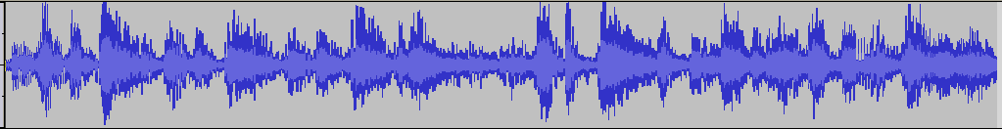
What is Sound?
Voice muscle vibrate and cause the air to move and thus cause sound (a series of waves)
Two people (or one person talking and music) talking causes two sets of overlapping waves. The overlapping waves actually form a new wave
Play audio clip
Bells
Oh

Slide 10
How do computers represent sound?
Computer must somehow represent the wave.
Question: What two things does a computer always do when it needs to represent something?
Sample
Quantize

Slide 11
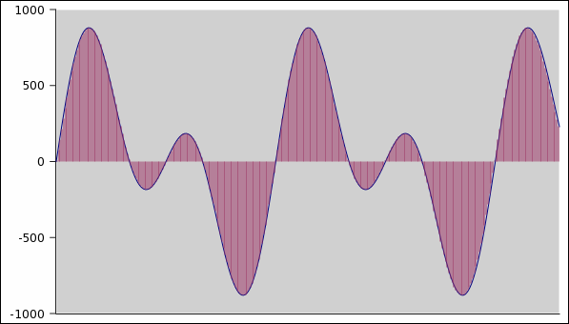
How do computers represent sound
Question: In the following sound wave image what is wrong if we take a sample of the wave every 5 units?
0 1 2 3 4 5 6 7 8 9 10 11 12 13 14

Slide 12
The Nyquist Limit
This rule says you MUST take at least 2 samples for every cycle of the wave. If you take less than two sample, you will get a completely different sound wave:
Question: Which of these sound waves has a higher pitch?
Question: What does the Nyquist Limit rule imply about taking samples for higher pitched sounds than lower pitched sounds?

Slide 13
Sampling
We MUST take 2 or more samples per wave
Question: what is the advantage of taking lots of samples per wave?
Question: What is the disadvantage of taking lots of samples per wave?
Number of samples per second is represented in Hertz (Hz)
Number of 1000 samples per second is represented in KiloHertz (KHz)
For CD quality we need 44,100 samples per second or 44,100Hz or 44.1KHz

Slide 14
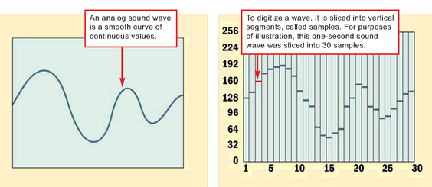
Sample Rate
Sample Rate → number of samples we take per second of audio or number of times per second the waveform is measured.

Slide 15
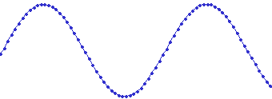
Sample Rate
Each dot represents a sample:

Slide 16
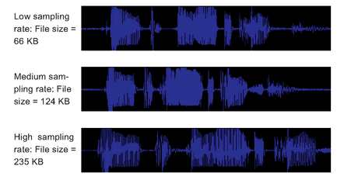
Typical Sample Rates
Voice Only (Telephone Quality)→ 8KHz
AM Radio Quality →11.025 KHz
FM Radio Quality→ 22 KHz
CD Quality Music → 44.1KHz

Slide 17
Sample Rate Example
One of these was sampled at 8000Hz (8KHz) and one at 16000Hz (16KHz).
Question: Which one should sound better?
Question: Which one does sound better?
One
Two

Slide 18
Quantizing – (aka →Sample Size)
Now that we know how many samples we will have (likely one of 22KHz or 44.1KHz), how do we represent either sample?
Question: What would 1-bit sound look like? (remember 1-bit or 8-bit or 24-bit colour)
0
1
0 0 0 0 1 0 1 0 1 0

Slide 19
Sample Size
How about 2 bit sampling? (this will only be 4 tones ☹ (thus not even as much as the notes in one scale, so you would just have Doh, Ra, Me, Fa but NO So, La, Te, Doh. Keep in mind though that the bits represent tones not notes!)
00
01
10
11
01 00 01 01 11 01 10 01 11 01

Slide 20
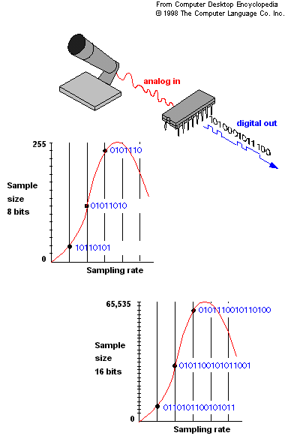
Sample Size
CDs use 16-bit rate (65,536 possible values could be given to each sample)
Question: What is the advantage of having a higher bit rate for the sample size?
Question: What is the disadvantage of having a higher bit rate for the sample size?

Slide 21
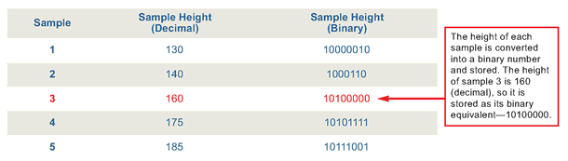

Sample Size

Slide 22
Sample Size
Question: Can you tell which is better quality?
One
Two
Three
I can’t ☹

Slide 23
How does the sound wave get converted to be stored on our computer?
Computers have a sound card which samples (sets the number of sample and quantizes) the sound wave from a microphone.
Sound card has an Analog-to-Digital Converter (ADC) for recording, and a Digital-to-Analog Converter (DAC) for playing audio.
Operating system (Windows, Mac OS X, Linux, etc.) talks to the sound card to actually handle the recording and playback

Slide 24
Test your Hearing
https://www.npr.org/sections/therecord/2015/06/02/411473508/how-well-can-you-hear-audio-quality
https://www.theverge.com/2017/4/5/15168340/lossless-audio-music-compression-test-spotify-hi-fi-tidal

Slide 25
Sound Editing
Now we have the sound in the computer, let’s edit the sound bit. What can we do to it?
Rearrange the Waveform
Cut, copy, drag, trim parts of the waveform
Overlap two or more pieces of audio
Find words you want to edit out and cut them from the wave form.
Modify the Volume
Use amplify, fade-in, fade-out, envelope, normalize
Sometimes songs from some CDs playing much louder than others, even at the same volume setting. Normalization corrects this by scanning audio files to find peak or average level and proportionally increasing or reducing the levels to obtain the desired volume level. http://www.hometracked.com/2008/04/20/10-myths-about-normalization/ (go to myth 2, snare drum vs. entire clip)

Slide 26
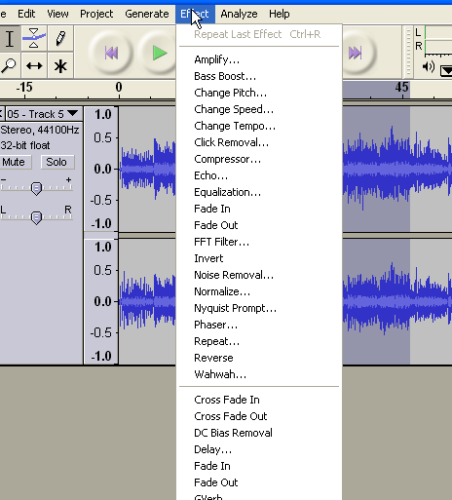
Sound Editing
Noise Reduction
Hiss Reduction → noise within a given frequency range
Noise Reduction/Removal → software examines the audio and finds unusual differences from waveform and removes them. Need a longer piece of audio than for Hiss Reduction because software had to analyze the audio to generate stats on what is unusual. http://www.alpinesoft.co.uk/vinylstudio/samples.aspx (go to Hiss Sample 4)
Special Effects
Adding echo, changing the pitch of a portion
Downsample and reduce the bit depth→i.e. compress, WHY COMPRESS?

Slide 27
Why compress sound?
An example of uncompressed sound with CD quality for 1 minute of audio:
1 minute of recording → 60 seconds
60 * 44,100 samples/second → 2,646,000 samples
2,646,000 samples * 16bits per sample → 42,336,000 bits
42,336,000 bits * 2 (stereo, 2 channels) → 84,672,000 bits
84,672,000 bits / (8bits per byte) →10,884,100 About 10 MB (Megabytes)!!!
A typical CD can hold about 737MB (or 80 minutes of audio)

Slide 28
Sound Compression Strategies 4 Basic Strategies:
Reduce the number of samples (sample rate)
Reduce the bit depth (sample size)
Reduce the channels
Compress using the appropriate codec

Slide 29
Reduce the Sample Rate
Go from 44KHz to 22KHz (this will affect the quality)
Example: Go to Audio Demo on this page: http://www.cs.cf.ac.uk/Dave/Multimedia/node150.html
Note: All else staying equal, halving the number of samples will approximately half the file size
File Type (all at 8 bit) | File Size
44 KHz | 1.3 Mb
22 KHz | 424 Kb
11 KHz | 120 Kb

Slide 30
Reduce the Sample Size
Go from 16 bit to 8 bit (this will affect the quality)
http://www.cs.cf.ac.uk/Dave/Multimedia/node150.html
Note: All else staying equal, halving the bit depth will approximately half the file size
File Type (all at 22KHz) | File Size
16-Bit | 740 Kb
8-Bit | 424 Kb

Slide 31
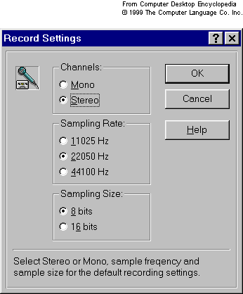
Reduce the number of channels
In mono there is one channel
In stereo there is two channels
Changing from stereo to mono will ½ the size of the file

Slide 32
Pick the appropriate codec
Codecs for audio can be either lossy or lossless. NOTE: almost all are lossy!
File Formats that use lossy codec:
Question: Does anyone know the most famous audio file format that does lossy compression?
Hints:
Start to become popular in the early 90s
Can compress a song from a CD (songs on CDs are 44KHz, 16bit and uncompressed) to:
1/11 of its size!
Based on the idea that some tones become unable to hear when another tone is present

Slide 33
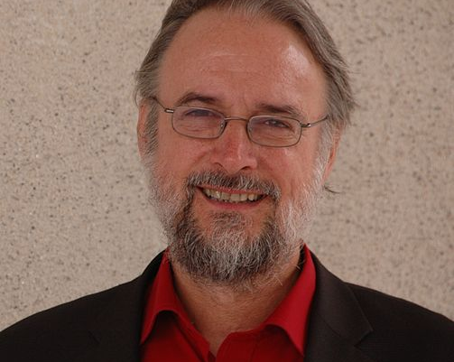
In a 2009 documentary about the history of the song by Swedish SVT, Brandenburg said: I was finishing my PhD thesis, and then I was reading some hi-fi magazine and found that they had used this song to test loudspeakers. I said "OK, let's test what this song does to my sound system, to mp3". And the result was, at bit rates where everything else sounded quite nice, Suzanne Vega's voice sounded horrible.^{[8]}Brandenburg adopted the song for testing purposes, listening to it again and again each time he refined the scheme, making sure it did not adversely affect the subtlety of Vega's voice. From Wikipedia
Karlheinz Brandenburg
Researchers heard this song and because of the nuances in her voice used it to perfect the compression (Tom’s Diner)

Slide 34
Audio Compression
File Formats that use lossless codecs/compression:
There are a few but not very common
Common File Formats that are uncompressed:
.wav (very common, 44KHz, 16bit)
.aiff
CDDA(Compact Disc Digital Audio defined in the Red Book which contains audio standards) → standard for CDs, 44KHz, 16 bit per sample, 2 channels.
Thus 1 second of music must be played at a bit rate of: 44100*16*2*1=1,411,200 bits per second = 1411.2Kbits per second
Compare with: mp3 →128Kbits per second is most common, makes it good for the Internet!

Slide 35
Audio Compression
NOTE: .wma and .mp4 are lossy AND allow for built-in lockdowns which is why Microsoft and Apple are pushing them ;-)
Used to be if you put sound into your Flash animation you would never have to worry about the sound not playing because every computer comes with a Flash Player ☺ (no need to download a plugin)
However, ipads and other Apple products won’t play flash so this isn’t as true as it used to be!

Slide 36
Audio File Formats
Audio Format | File Extension | Advantages | Disadvantages
Advanced Audio Compression | .aac | Good sound quality Used on iTunes Used on YouTube, iPhone, PlayStation, BlackBerry | Copy protected Limited to approved devices
Audio Interchange Format | .aif /.aiff | Excellent sound quality Supported without a plug-in Mac format | Uncompressed so large files
MP3 | .mp3 | Good sound quality even though compressed Can be streamed over the Web | Requires standalone player or browser plug-in
Real Audio | .ra, .rx | High Compression Very small files Can be streamed over the web | Sound quality not great Requires a player or plug-in
Wave | .wav | Good sound quality Supported without a plug-in | Uncompressed, very large files
Windows Media Audio | .wma | Good sound quality even though compressed Used on music download sites | Files can be copy protected Requires Windows Media Player 9 or higher

Slide 37
MIDI Sound
There is another completely different way to make sound (rather than manipulating the waves).
Question: How does a MIDI file works?

Slide 38
MIDI Music
MIDI deals with music and synthesized sound, it does not handle voices or noise well.
There is no sampling or quantizing when storing MIDI files.
MIDI files hold information about music or sound such as:
Which instrument is supposed to be represented
The note being played
How hard the note was pressed
Question: Can any of you musicians think of one more thing it would need to store about a note?

Slide 39
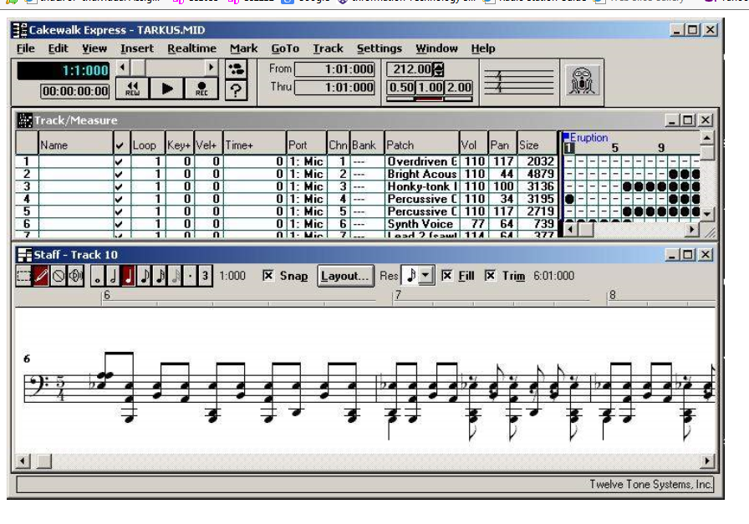
MIDI Files
Software such as Cakewalk, Cubase and Finale can be used to create and edit MIDI music.
Question: MIDI software offers a Staff View, what do you think that means?
Question: What are the advantages of MIDI files?
Question: What are the disadvantages of MIDI files?
NOTE: 3 minutes of MIDI file will be about 10KB, 3 minutes of uncompressed waveform will be about 15MB
Notes:
Staff View working with notes and on a sheet of music
Advantage: Small File sizes, easy to edit and change → 3minutes
Disadvantage: Doesn’t work for voice, cant incorporate into a website easily (need to convert to wav or mp3)

Slide 40
Take the MIDI test!
http://www.caseyrule.com/projects/piano/
Problem with MIDI recordings is that they are sometimes too perfect. See if you understand what we mean, listen to both of these recordings:
One
Two
QUESTION: Could you tell which one was live and which was a MIDI file?

Slide 41
Audio can be streamed too!
Downloadable Audio |  | Streamed Audio
Advantages | Disadvantages | Advantages | Disadvantages
Once downloaded, can be replayed, edited over and over (don’t need to wait again for download) | Takes a long time to download, especially for big files | Plays immediately | Cant rewind, pause, etc.
Don’t need a special streaming web server to post the file | Takes up disk space on the computer to store it | Consumes RAM only while being played, then purged after | Need a special server to post it
Example: Audio Files on Limewire |  | Example: cbc radio

Slide 42
Posting Sound on the Web
Can either:
Have a link to music that the user clicks on. Music will never start playing on the web page until the user clicks on link:
<p>Download a <a href="dearmom.wav">sound file </a> </p>
Have the music embedded in the web page: <audio controls loop> <source src="dearmom.wav" type=“audio/mpeg” > </audio>

Slide 43
Things to think about when incorporating sound into your site:
Will I have to edit the sound again (don’t compress it just yet)?
Will it need to be on the web, need good compression?
Will it need to be streamed, need VERY good compression?
Will be downloaded?
Will the user listening to this sound require a plug-in?
Is it voice only (can lower the number of samples)?

Slide 44
REMEMBER…
Please fill in the Feedback form: https://feedback.uwo.ca

Slide 45

We left in this slide from the spring of 2020…
Wash your hands
Stay home as much as you can
Stay healthy and keep others healthy
Sorry that cs1033 wasn’t exactly the course we were expecting this year
In the words of Western’s Dean of Science, Dr. Davison:
BE KIND TO ONE ANOTHER

